Slide 1
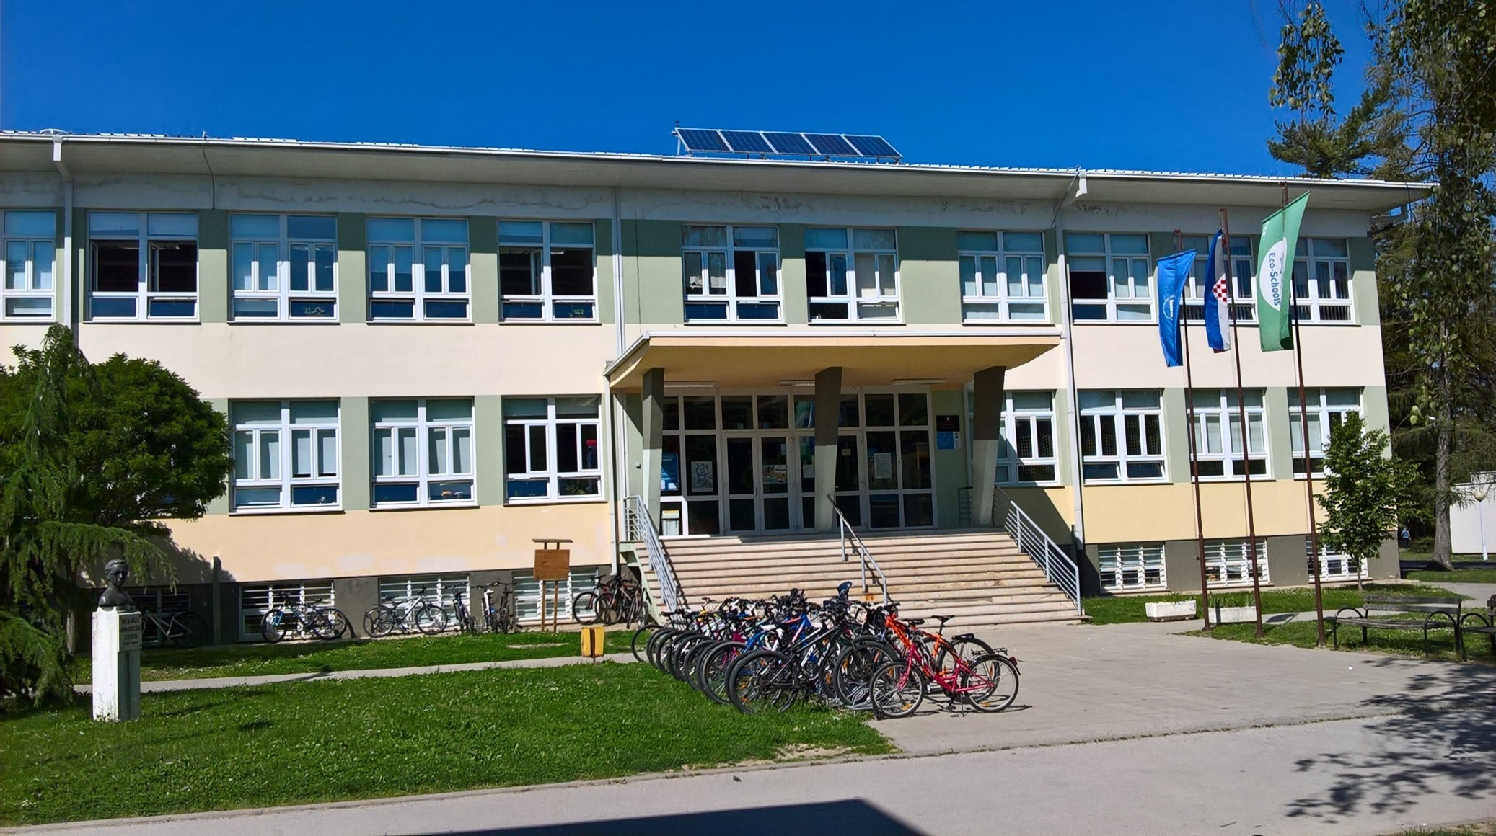
Republic of Croatia Primary school „Đuro Ester” Koprivnica

Slide 2
SCHOOL MOTTO
School and parents working together on the development of their child who doesn’t have to be an excellent student but can become an excellent human being.

Slide 3
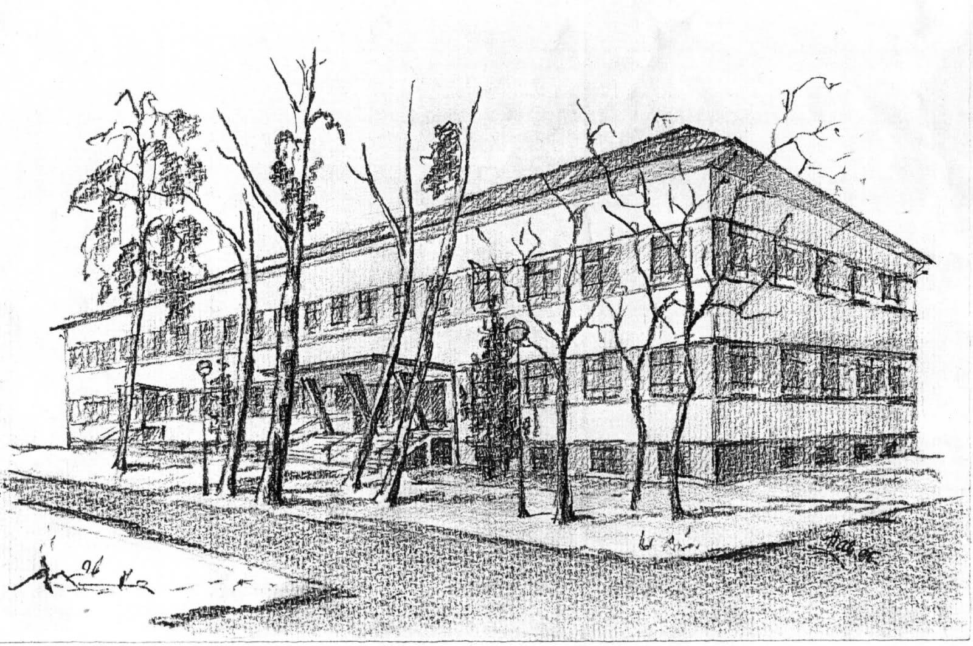
Sketches from the history of the „Đuro Ester” school
30. 10. 1959 – 3rd primary school in Koprivnica
founded
1975 – The school moves into a new building– the
present building of the central primary school
1984 – The school changes its name into Primary
school Branko Jambrešić-Zriko
1991 – at the proposal of the teaching staff the school
is named into today’s – Primary school „Đuro
Ester”, after a teacher, pedagogue and comedy
writer from Koprivnica who lived in the 2nd half
of the 19th century

Slide 4
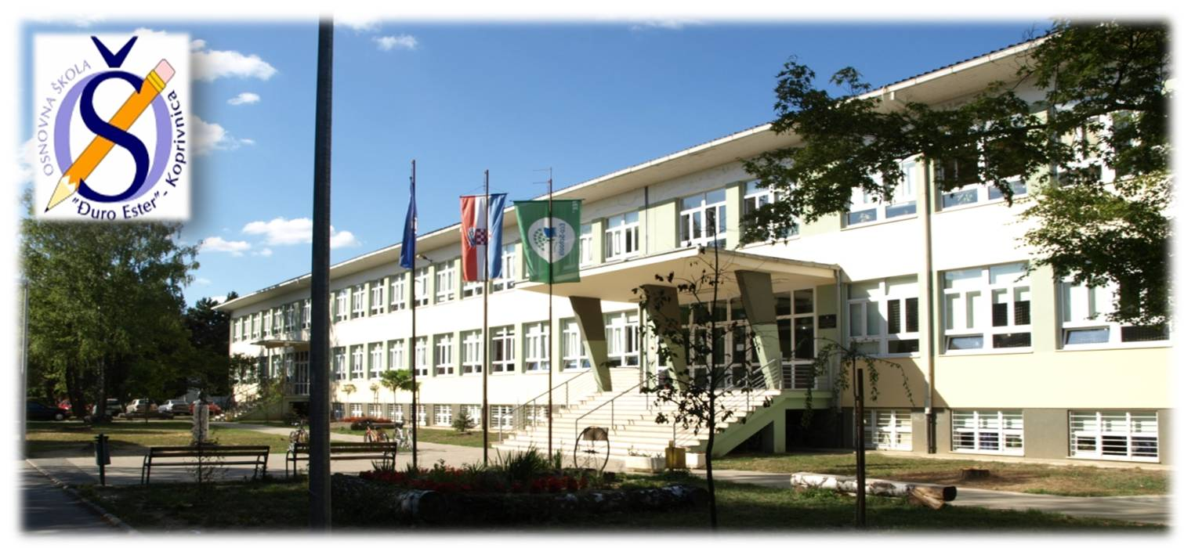
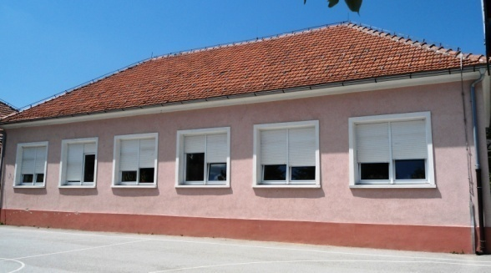
Basic information about the school „Đuro Ester”
Number of students: 745
Number of teachers: 47
Number of expert associates: 4 (a pedagogue, a social pedagogue, a psychologist and a librarian)
Duration of elementary education: 8 years
(Grades 1-8)
Foreign languages: English, German and French
The local school Vinica is part
of the central primary school
„Đuro Ester”.

Slide 5
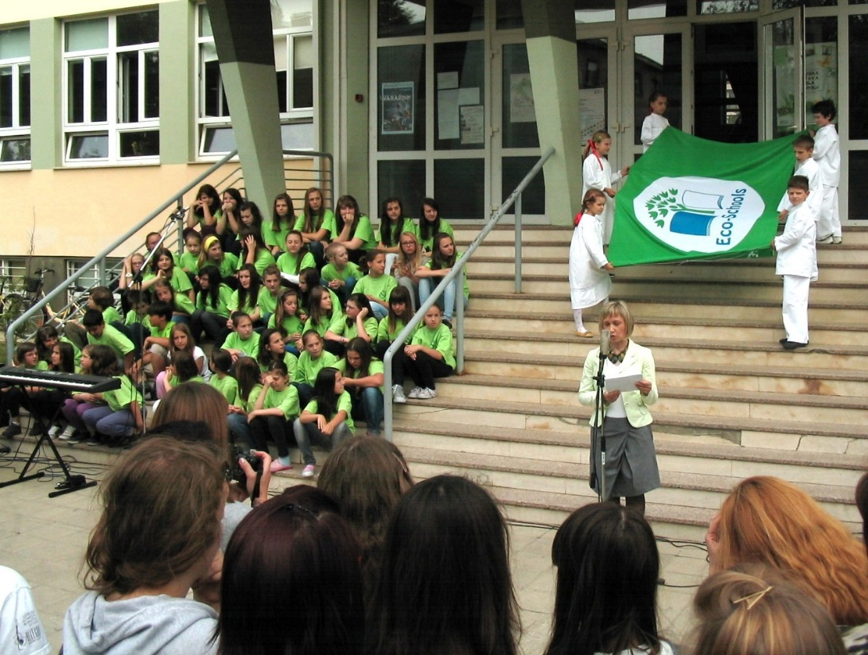
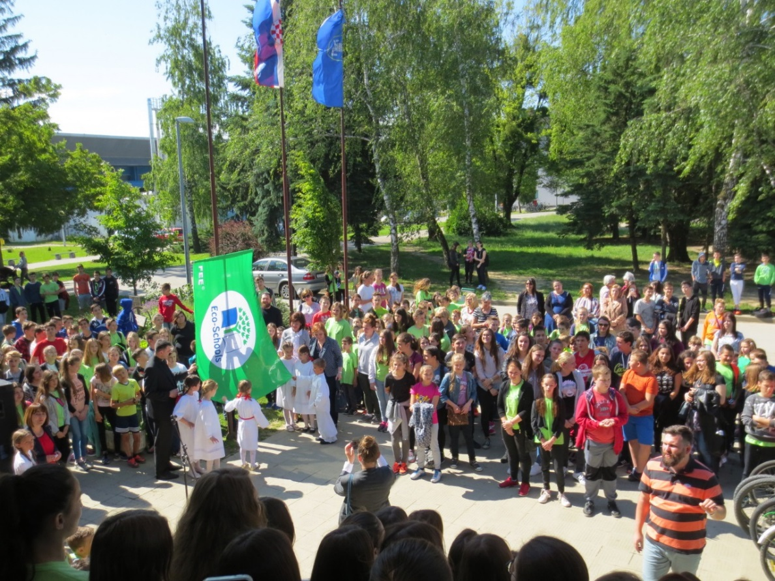
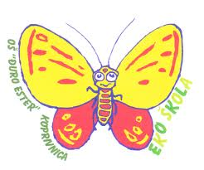
INTERNATIONAL ECO SCHOOL
2007. – Eco school status received
2013. – bronze status
2015. – silver status
2017. – gold status

Slide 6
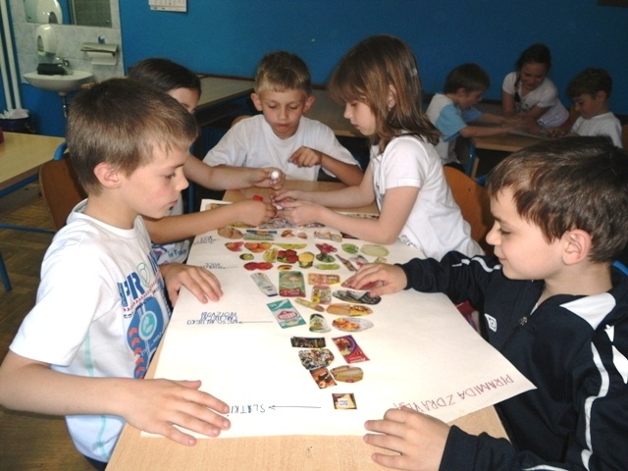
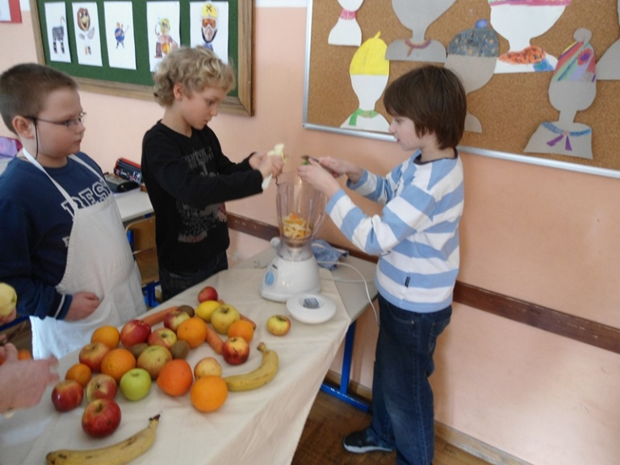
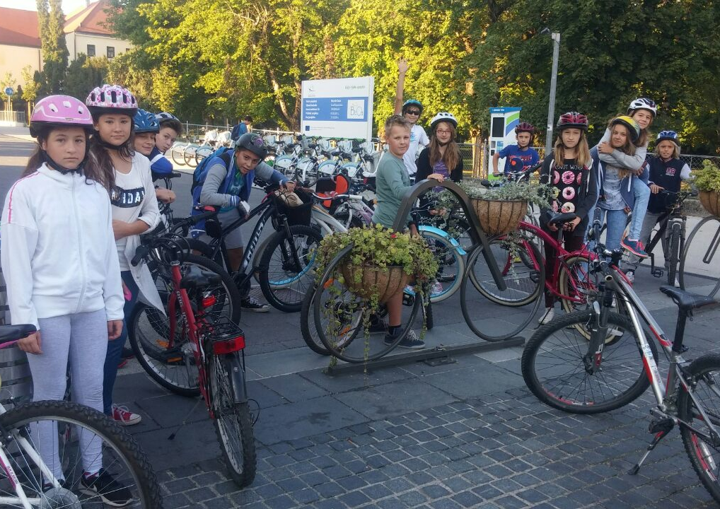
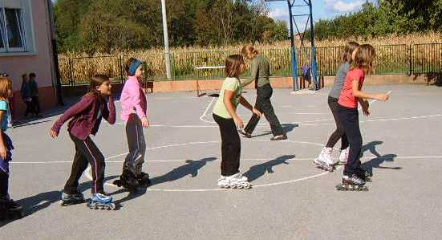
ECO SCHOOL activities
Healthy diet
Physical activity

Slide 7
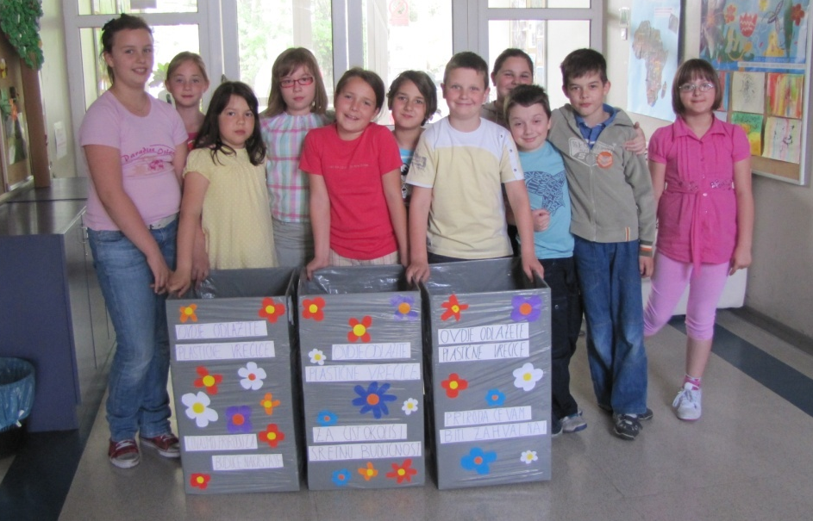
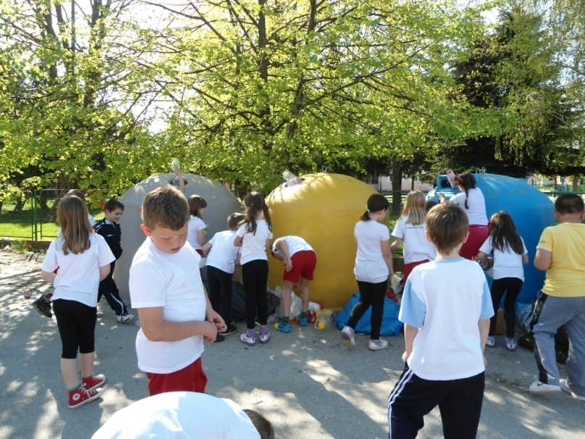
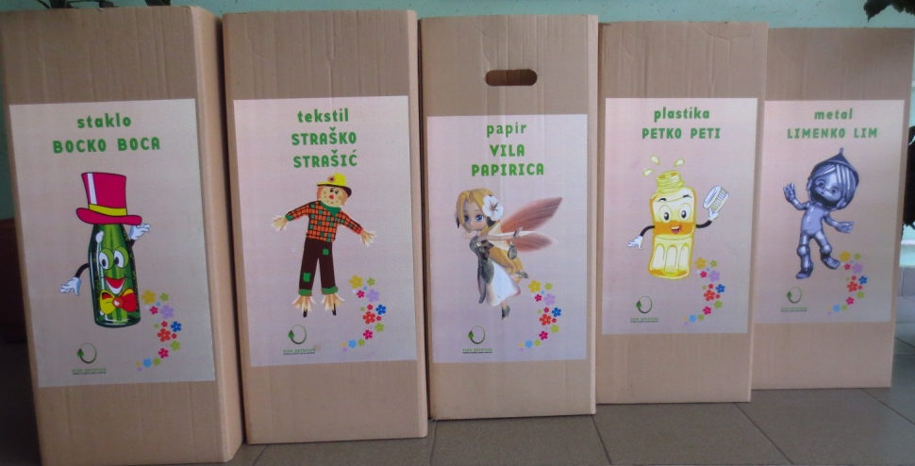
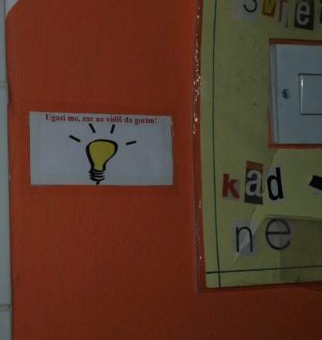
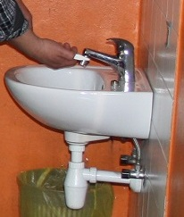
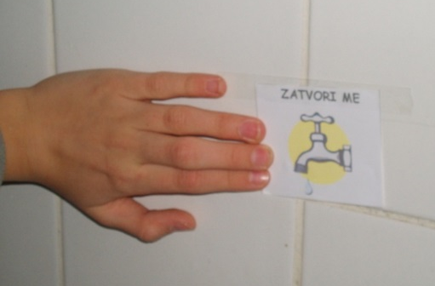
ECO SCHOOL activities
Waste sorting
Energy saving

Slide 8
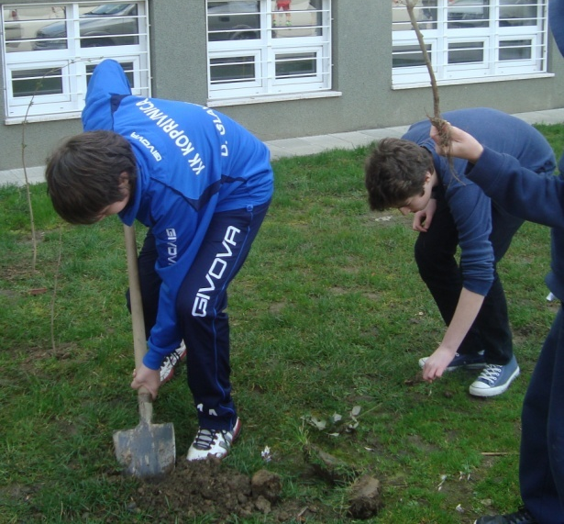
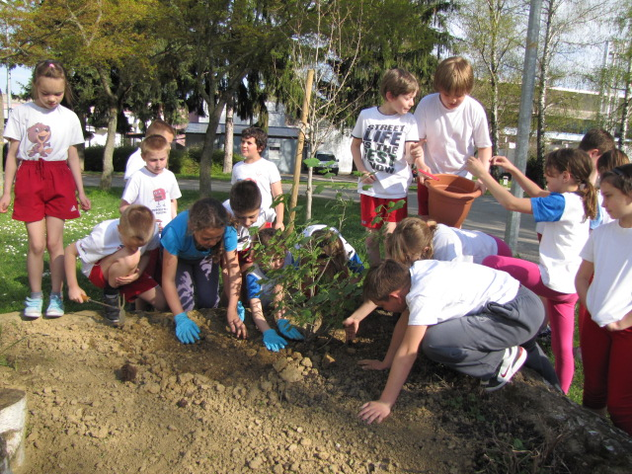
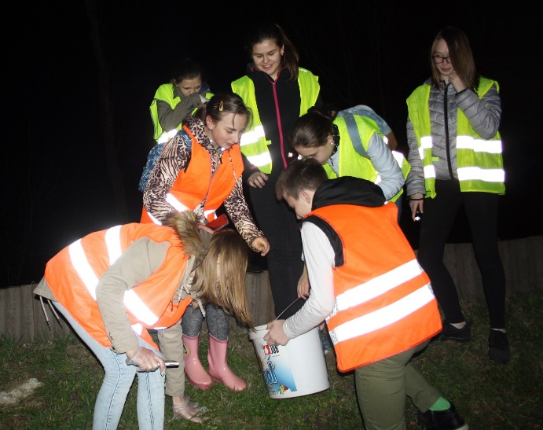
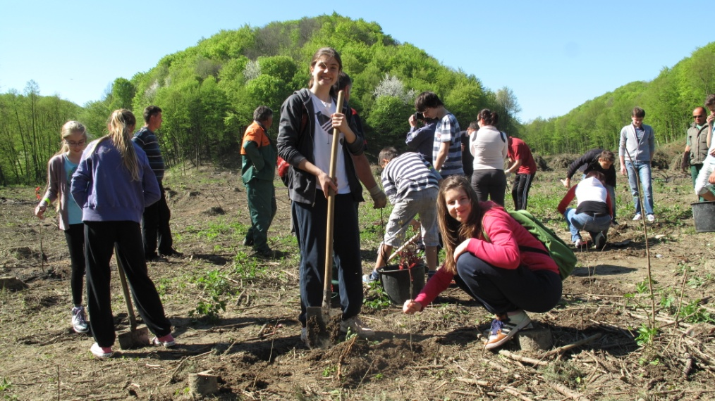
ECO SCHOOL activities
School landscaping , taking care of nature and the environment

Slide 9
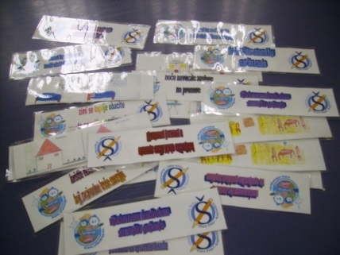
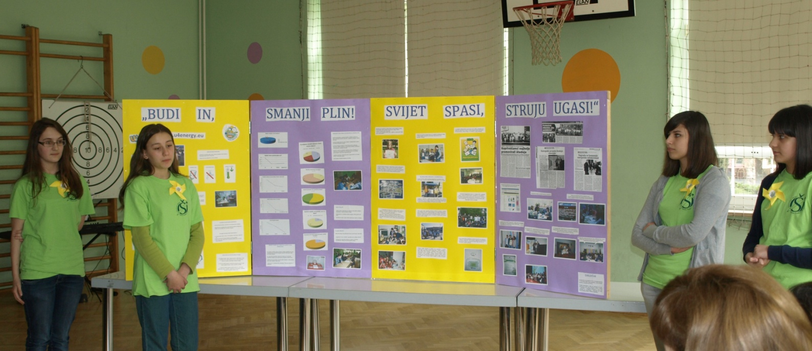
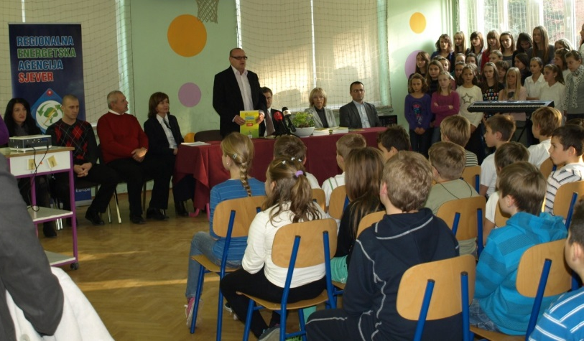
Success of our projects for raising awareness on energy efficiency
Be in – reduce gas consumption, save the world – turn off the lights!
in international competitions.

Slide 10
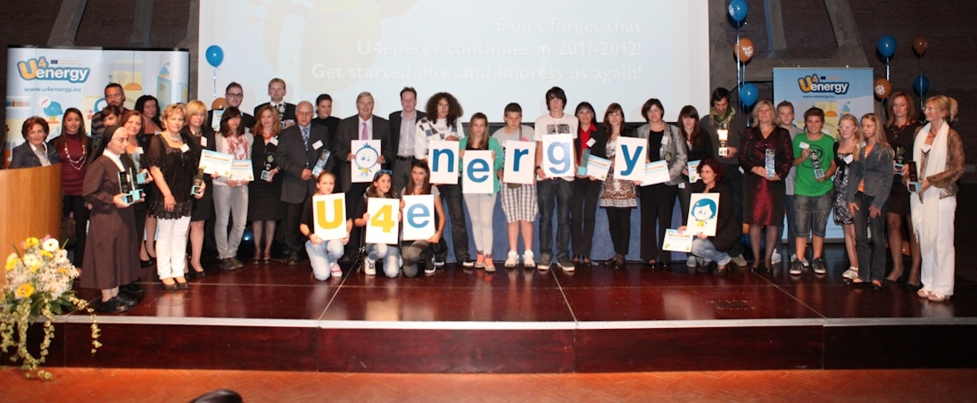
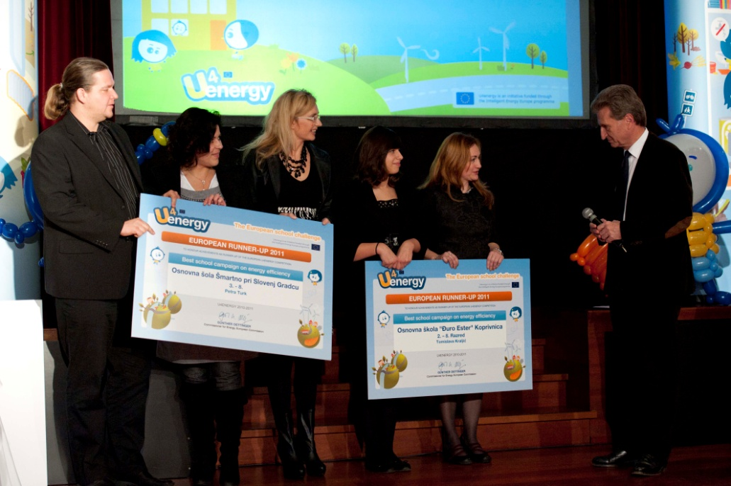
Naples – award ceremony for national winners of U4energy Competition.
Brussels – award ceremony
and the European reward
for activities and efforts in
promoting energy efficiency.

Slide 11
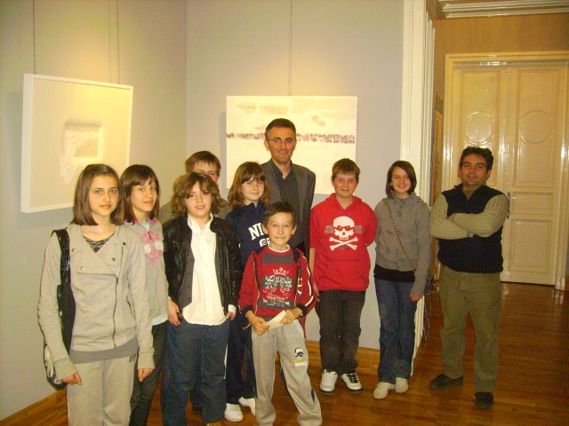
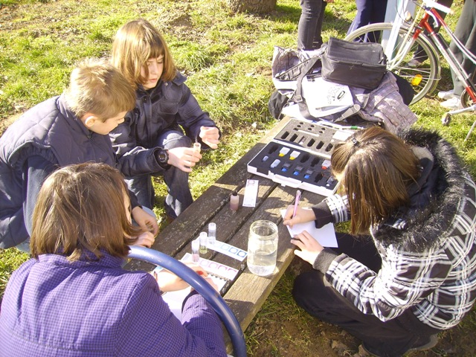
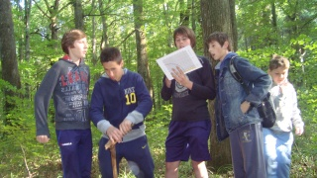
GLOBE Program in our school
- International science and education for life-long learning and observations to benefit the environment.

Slide 12
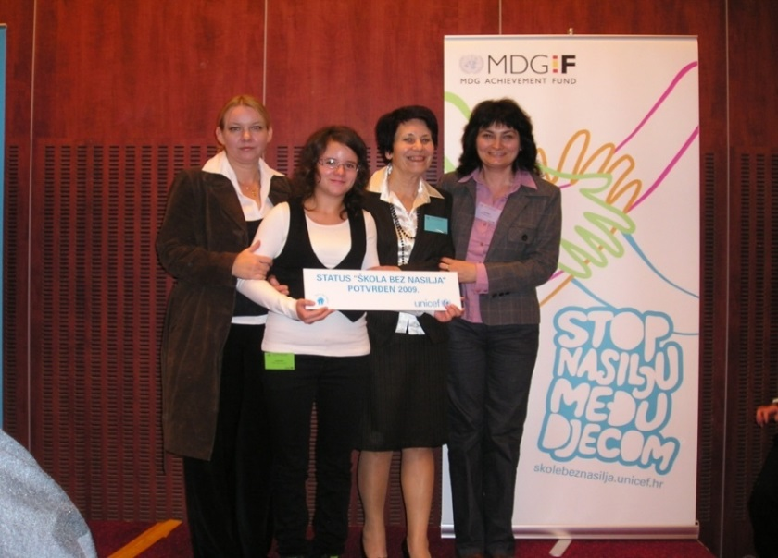
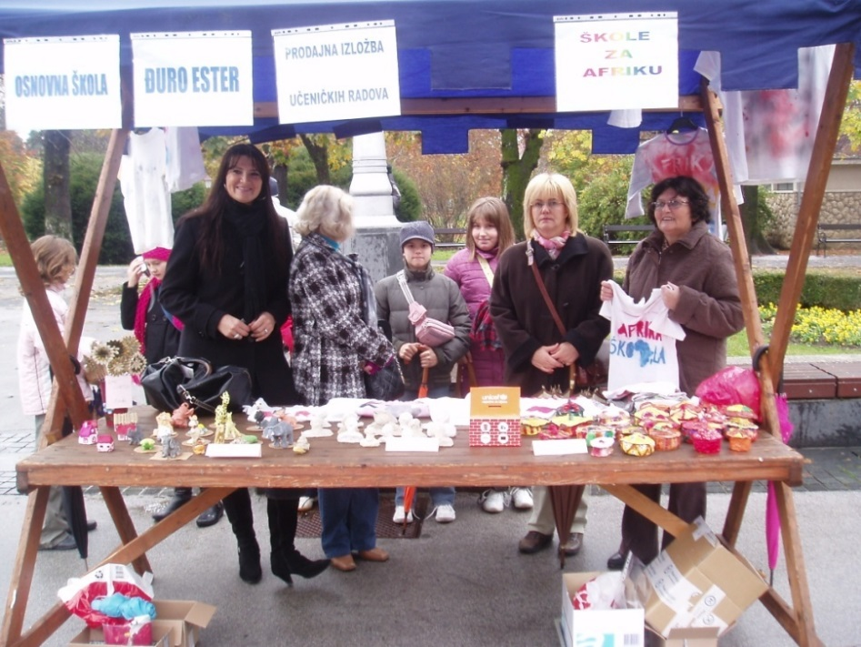
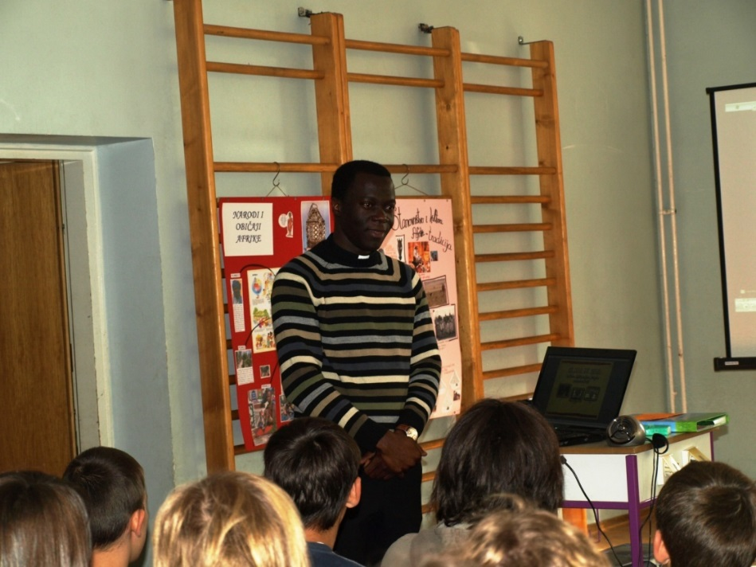
UNICEF – Violent-free School
UNICEF – Schools for Africa

Slide 13
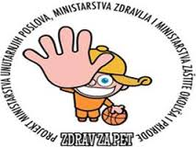
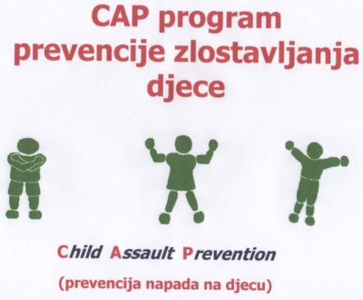
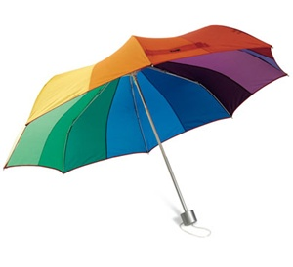
Projects our School participated in

Slide 14
School Projects in school year 2017/2018

Slide 15
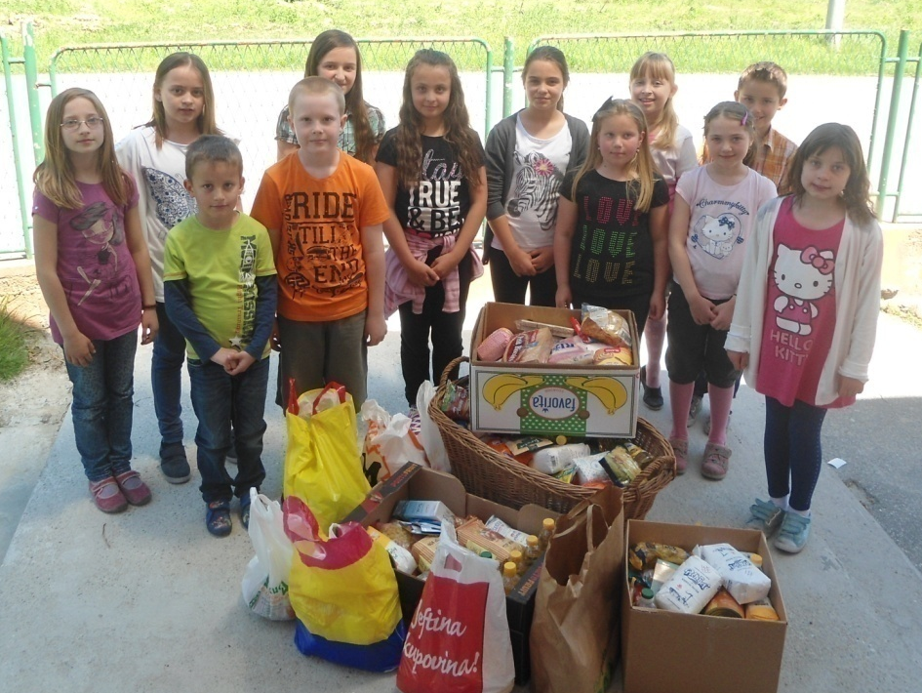
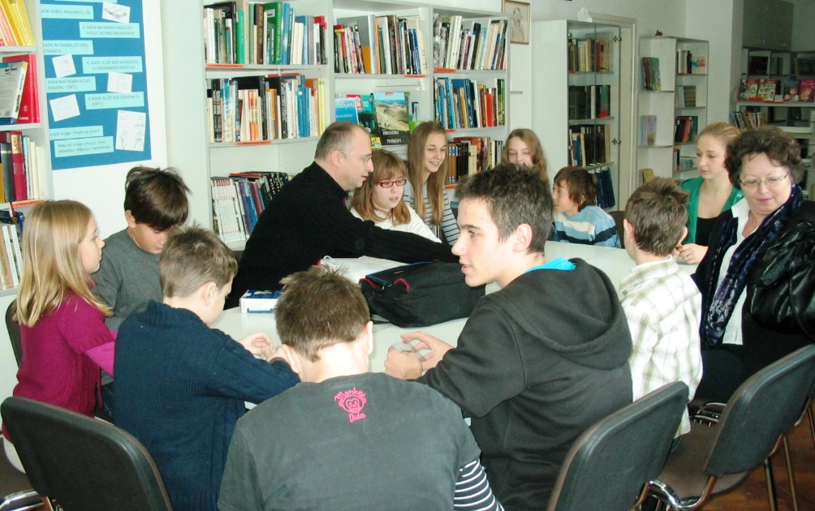
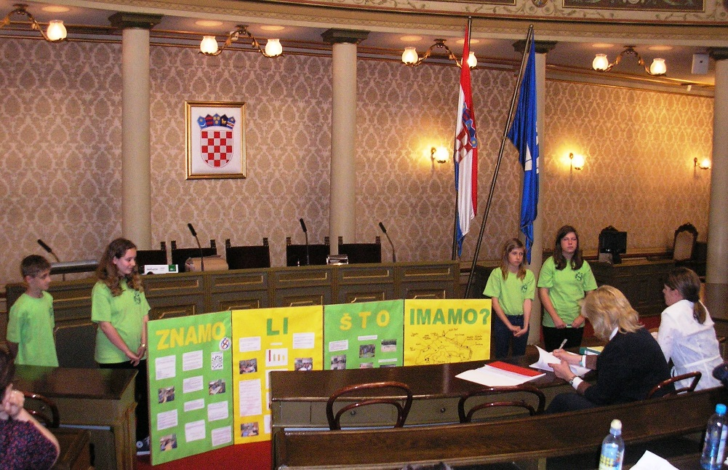
Experimental school for Civic Education
During school year 2012/2013 and 2013/2014, our school participated in the experimental program of civic education – education in human rights and democracy.
Goals: strengthening civic competences of our students and active inclusion in our community.

Slide 16
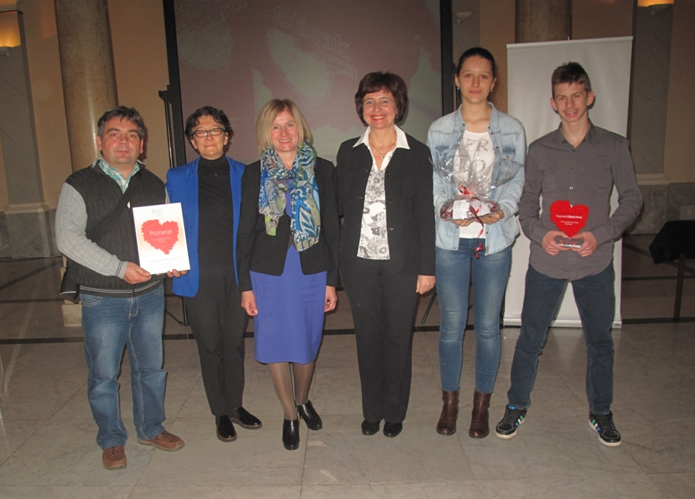
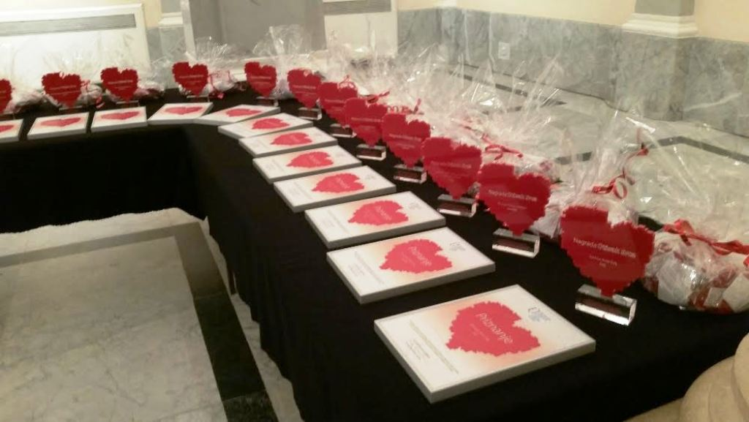
Prizes for pupils volunteers and their humanitarain work in the comunity

Slide 17
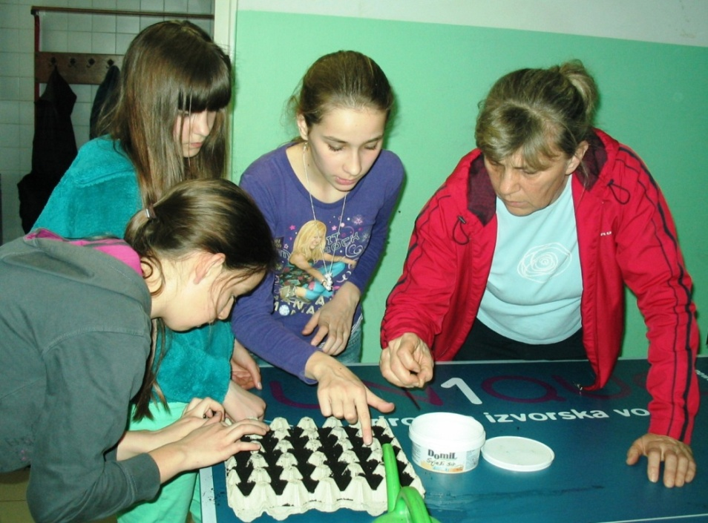
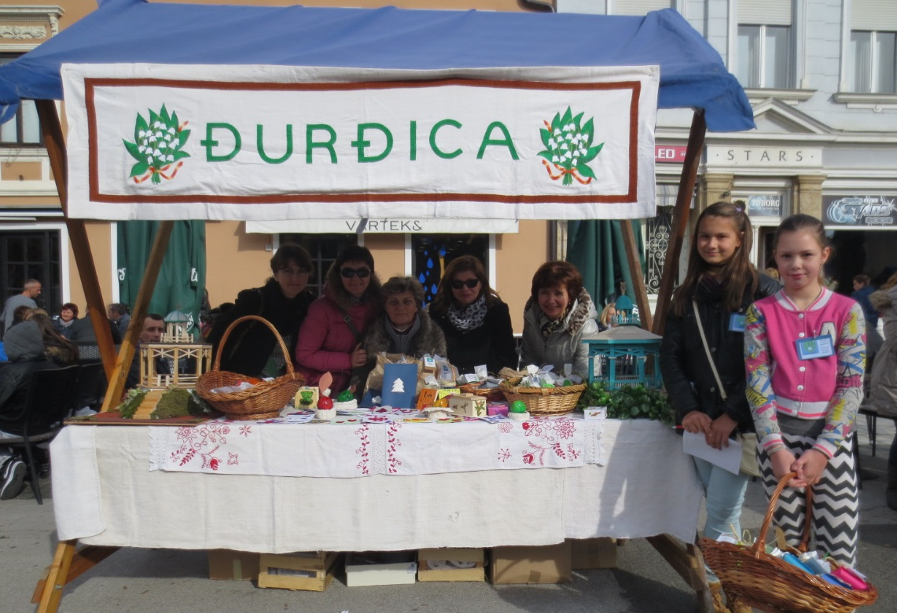
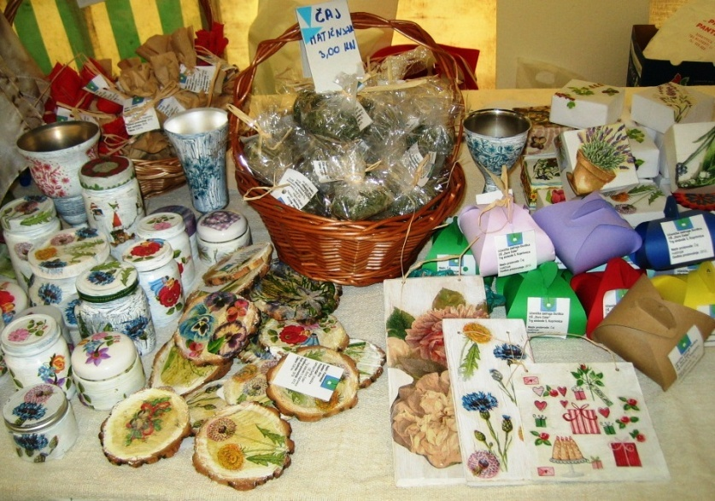
Pupils' cooperative „Đurđica“
active since 2012
develops entrepreneurial skills
plant section
design section
marketing and promotion section
eco section
ethno section

Slide 18
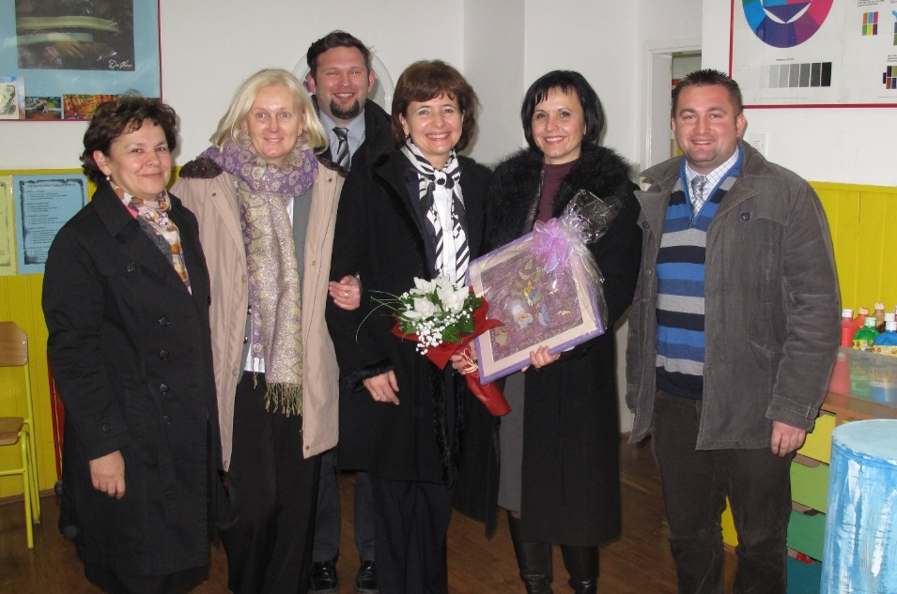
35 years of cooperation and friendship with „Olga Meglič“ school from Ptuj, The Republic of Slovenia
Friendship between these two schools started in 1982. by fraternization
Our cooperation continues through our projects, visits and professional excursions of teachers

Slide 19
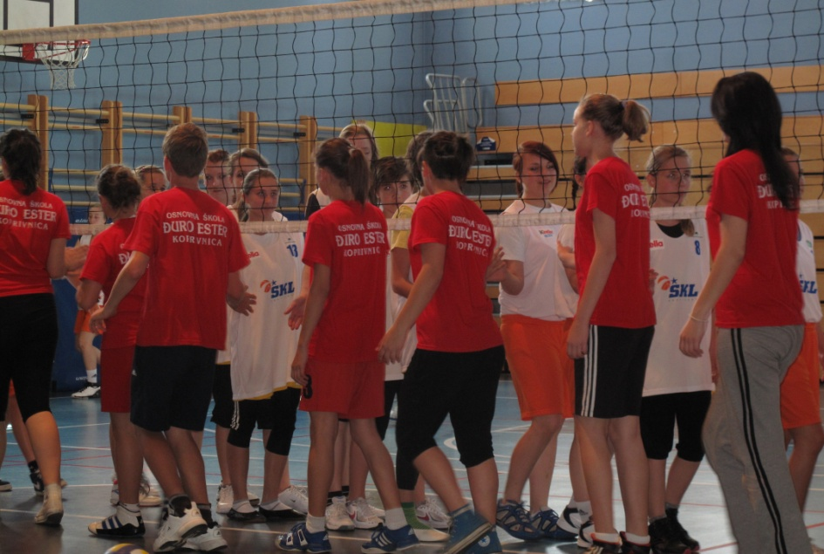
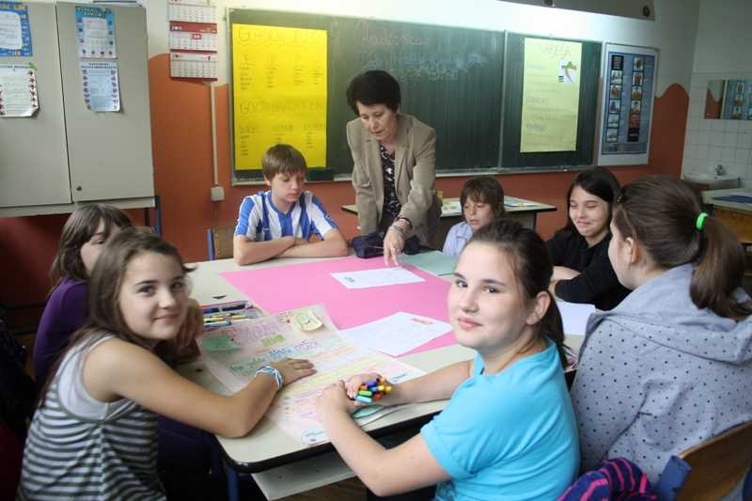
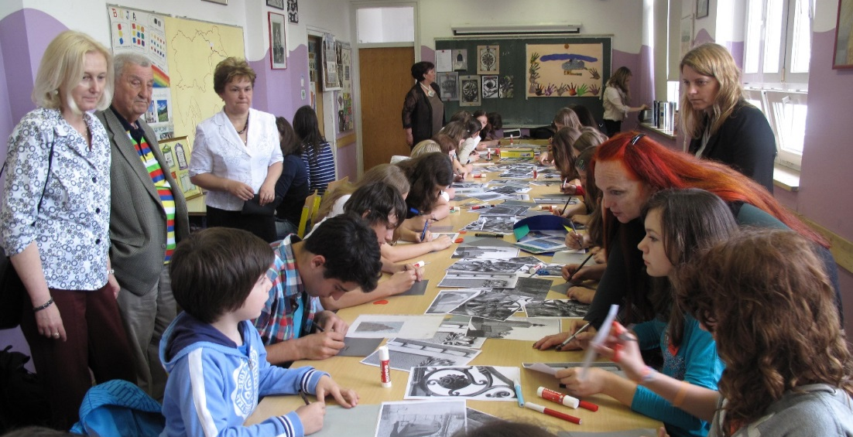
35 years of cooperation and friendship with „Olga Meglič“ school from Ptuj, The Republic of Slovenia
Our pupils participate together in various projects, cultural and sports activities.

Slide 20
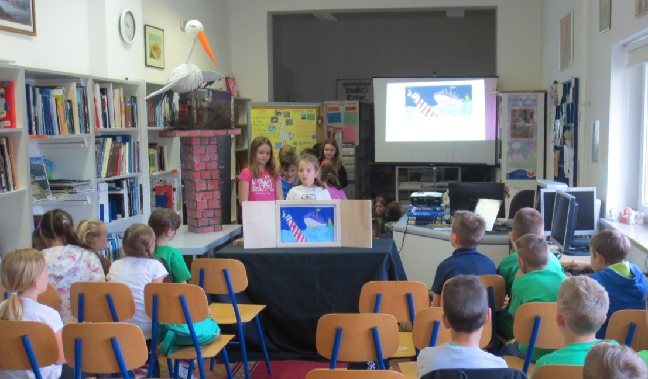
35 years of cooperation and friendship with „Olga Meglič“ school from Ptuj, The Republic of Slovenia
Since 2015 we have participated in the project „Reading knows no boundaries/Branje ne pozna meja“ as Partner-schools.
Aims: Discovering literature, culture and tradition of other people, developing communication skills, informatics literacy and ICT skills.

Slide 21
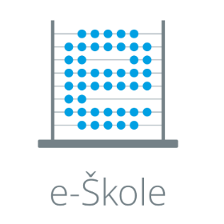
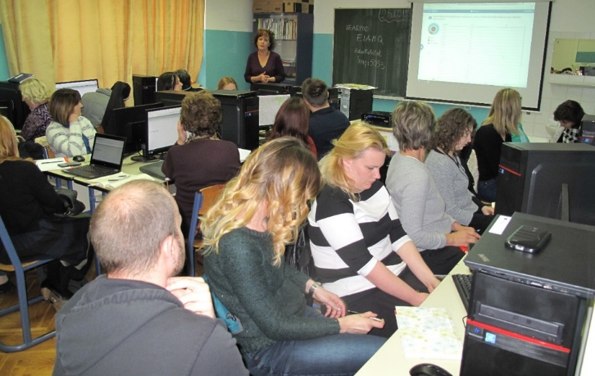
School European projects in 2017/2018
E-schools – Framework for the digital maturity of schools
Erasmus+
Going the Extra Mile (KA1)

Slide 22
School European projects in 2017/2018
RoboTech – development of a module for the optional school subject Robotics in the INTERREG Hungary - Croatia cross-border programme
„Knowledge as a gift“
professional development of teachers
working with gifted pupils

