Slide 1
WRITING PRACTICE
A POSTCARD FROM ICELAND

Slide 2
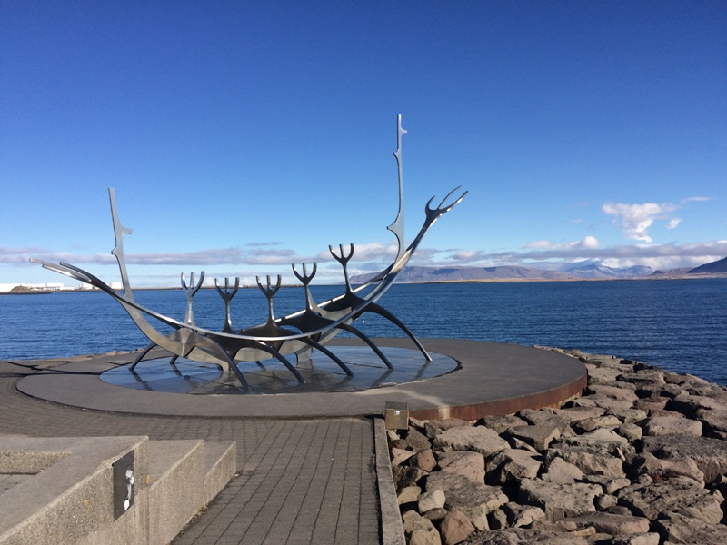
TASK
You are in Reykjavik, Iceland.
Write a postcard to your teacher.
Organize your postcard in 3 paragraphs.

Slide 3
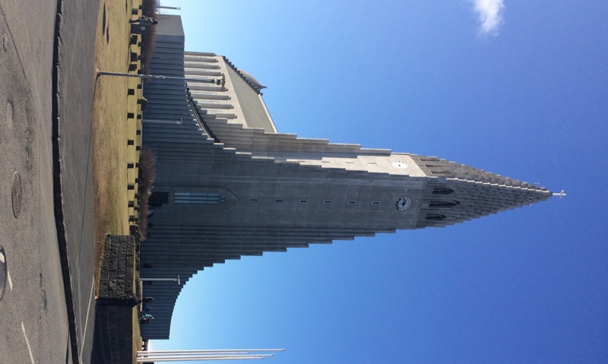
Include the following information:
use the appropiate beginning
Where are you?
Where are you staying?
Who are you with?
What are the most interesting sights there?
What do you do every day?
What's the food like?
What's the weather like?
How do you like it?
When are you coming back?
use the appropiate ending
sign your postcard

